Slide 1


BAC Presentation 2025
August Blomquist, Oliver Cheng, Alireza Darvishzadeh,
Nolan French, Jimmy Hernandez, Renata Krivenko, Connor Li,
Luke Olmos
Notes:
https://commons.wikimedia.org/wiki/File:OECD_logo.svg
https://www.stmarys-ca.edu/brand-guidelines/visual-identity-toolkit/logo-brand-identity-elements

Slide 2
Story
Horizon Development: U.S. Real Estate
  Considering New Markets (OECD Countries)
    Sage Wright and Alex Bond: Senior Investment Managers
  Concerns with Debt Trends
    $100T by 2030 (IMF)
  Public Sector Debt: Harms Interest Rates and GDP Growth
    Linked to Real Estate Profitability

Slide 3
Objectives
Assess Severity of Public Sector Debt
  37 OECD Countries from 2010 - 2023.
  Data via World Bank DataBank
Analyze Debt Trends
  Identify Causes of Trends
  Find influence of Economic Shocks
    Covid, Eurozone Crisis
Recommend Well-Performing Countries
  Public Sector Debt
  Response to Covid, Eurozone

Slide 4

Research Question
How have public debt conditions, trends, contributing factors, and their impacts on economic indicators across OECD countries from 2010 to 2023?
Notes:
https://horizondbm.com/

Slide 5
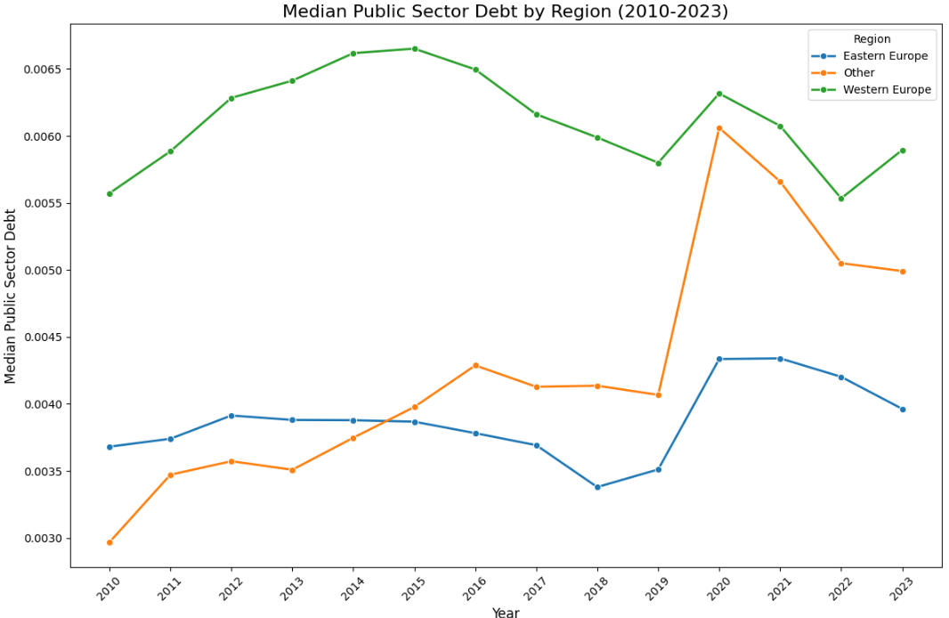
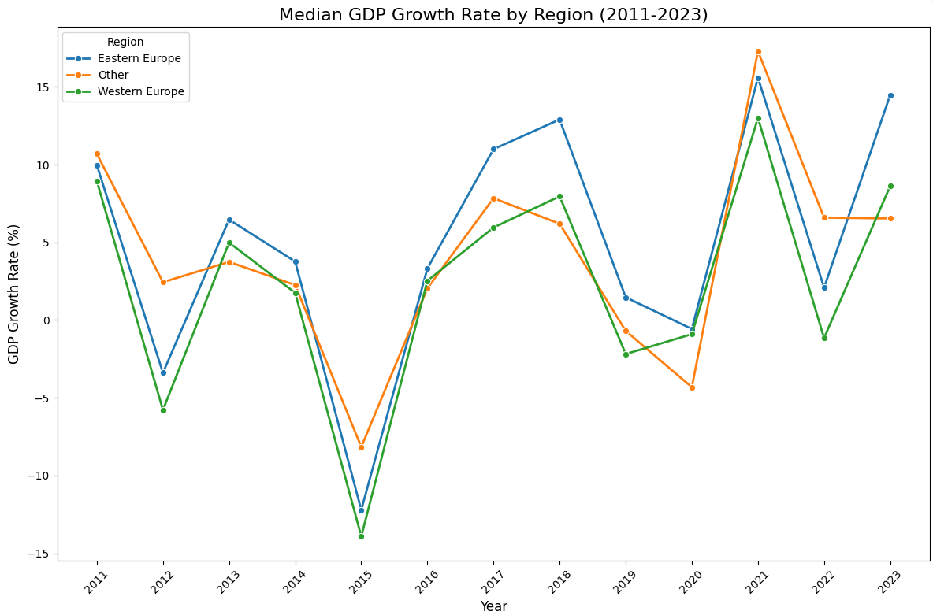

Slide 6
Data
Average Wages
Labor Force Participation Rate
Exports of Goods & Services
Imports of Goods & Services
National GDP (USD)
Standardized Population Growth
Unemployment Rate
Current Account Balance
Inflation Rate
Housing Pricing Indicator
Corruption Perception Index
FDI
Consumer Price Index (CPI)
Tax Revenue (% of GDP)
Urban Population Growth Rate
GDP per Capita
WUI

Slide 7
Methodology
All Variables converted into Year-over-Year (YoY)
Target Variable | Public Sector Debt (% of GDP)
Feature Variables | Economic Indicators
Regions | Euro (26 countries) Non-Euro (11 countries) All 37 OECD Countries
Time Periods | 2010 - 2012 (Eurozone) 2014 - 2019 (“normal”) 2020 - 2021 (COVID) 2022 - 2023 (“normal”)
Steps | Find Correlation + Significant Factors Derive Coefficients Predict 2024 - 2030 Public Sector Debt using 3 different methods and 3 unique scenarios.

Slide 8
Overview: Finding Public Debt Coefficients
Objective:
Estimate Coefficients of Economic Indicators
  Multilinearity (VIF)
  Significance (P-Value)
Country Dummies:
Dropping one country (USA) sets a baseline for comparison.
Helps reduce multicollinearity by simplifying categorical data into binary choices, making relationships between predictors more distinct.
Approach:
Use OLS (Ordinary Least Squares) - Method for fitting a linear regression line while taking into account multiple input variables (Factors)
Year Dummies:
Without year dummy
Covid (2020-2021)
Eurozone Crisis (2010-2012)

Slide 9
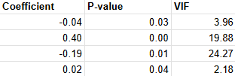
Data Limitations, Significance
High Multicollinearity
  Factors such as Labor Force have high VIF like 1300.
    Independent variables are highly correlated with each other.
Insignificant Variables:
  P-values greater than 0.05 considered insignificant.
Significant, Low Multicollinearity Factors:
FDI
Tax to GDP
Population Growth
Labor Force Participation

Slide 10
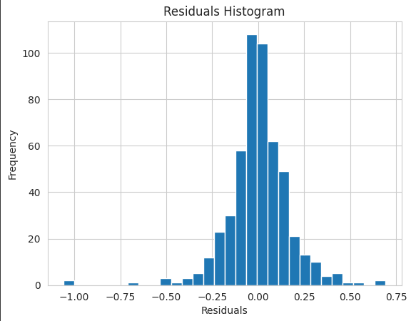
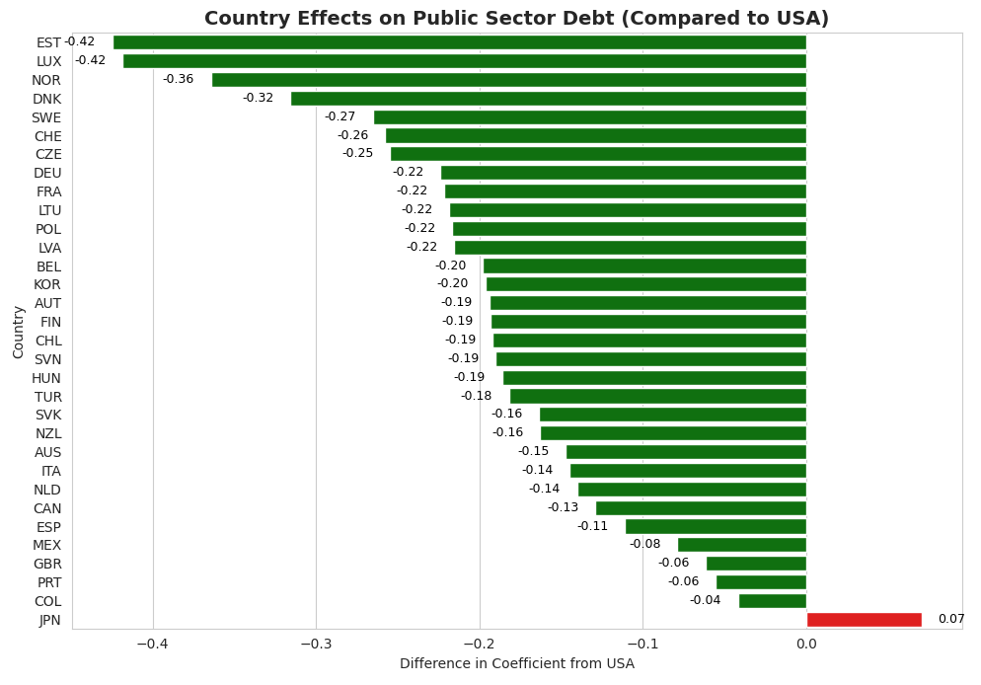
Results: Without Year Dummy
Adjusted R-Squared: 0.932 (Very good!)
Compared to USA (Dummy)
Japan: 0.0709
Luxembourg -0.418
Costa Rica, Greece, Ireland, Iceland not
significant (will be dropped anyways
due to WUI)

Slide 11
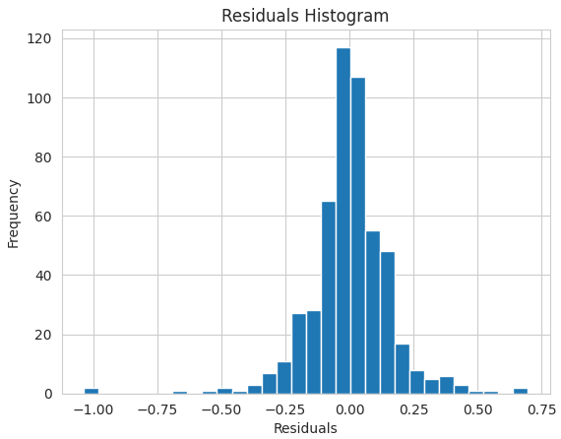
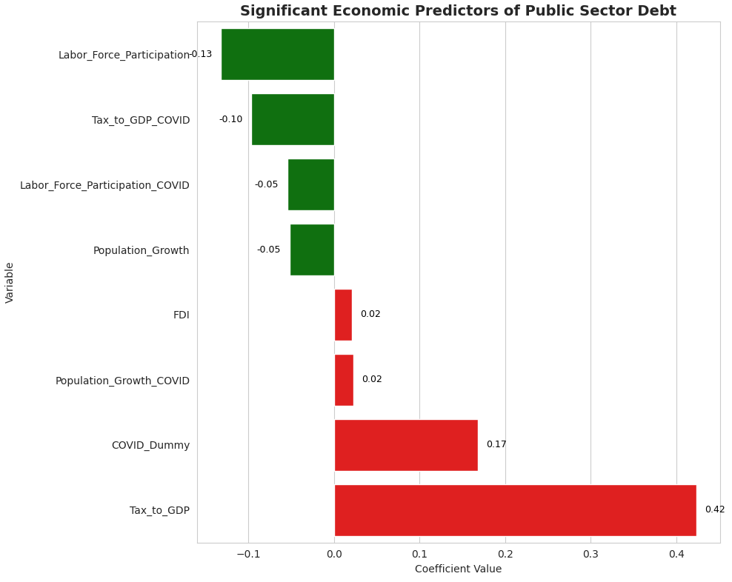
Results: Covid (2021-2021) Dummy
Adjusted R-Squared: 0.936 (Very good!)
Covid Dummy (0.17, p-val 0.00009)
Debt levels 17% higher in Covid years
Compared to USA (Dummy)
Japan: 0.08
Luxembourg -0.40
Costa Rica, Greece, Ireland, Iceland not significant (will be dropped anyways due to WUI)

Slide 12
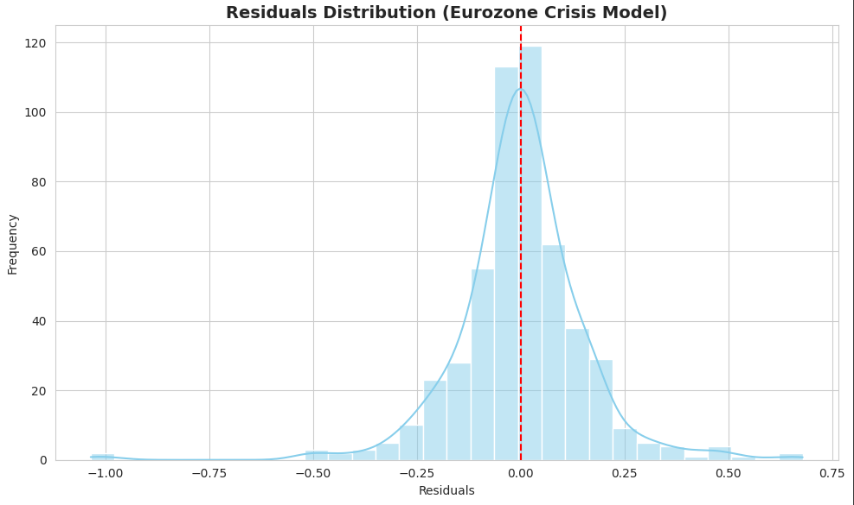
Results: Eurozone (2010-2012) Dummy
Adjusted R-Squared: 0.939 (Very good!)
Eurozone Dummy (-0.195, p-val 0.00008)
Debt levels 19% lower in Eurozone Years (Unexpected)
  Eurozone countries only account for less than a third of OECD Countries
  Crisis started in 2009, 2010-2012 could represent a “recovery period”

Slide 13
Recommendations and Conclusions
Countries that have high coefficients compared to USA throughout all periods:
Estonia
Luxembourg
Norway
Denmark

Slide 14
Next Steps:
Objective:
Implement use of the WUI to eliminate countries.
Use time series models to extend OLS across Normal (2014–2019), COVID (2020–2021), and Crisis Recovery (2010–2012) periods.
Forecast debt to 2030, leveraging significant predictors (FDI, Tax to GDP) and country dummies (USA baseline).
Use K-means clustering to separate countries into groups to recommend.
Create more visualizations.

Slide 15
References
Data Sources
Research Article

